Slide 1



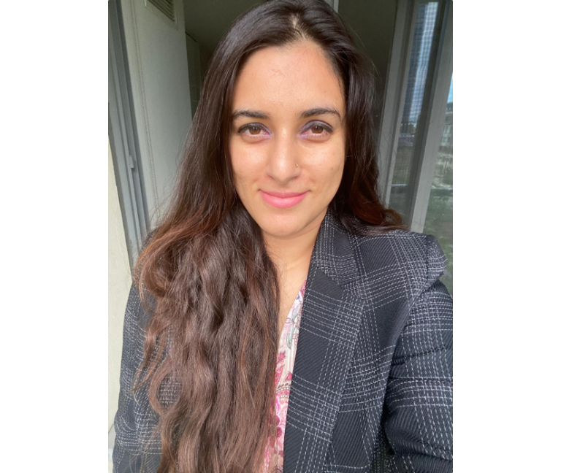


Unlocking Fraud Detection with Advanced Analytics
Isha Sharma’s expertise anchors the presentation
Introducing Isha Sharma and Data-Driven Risk Insights
Over 8 years blending finance, analytics, and data science to design innovative risk mitigation solutions
Overview of fraud trends sets analytical context
Leads with a strong foundation in analytics and fraud and risk detection strategies
Visuals establish credibility and frame discussion
Introduction images and trend graphs provide context essential for the detailed techniques ahead

Slide 2



Isha Sharma’s Professional Journey
From foundational finance roles to leading fraud detection with advanced data science
Expanded knowledge with machine learning and data science to enhance analytical capabilities.
Advanced Data Science Studies
2018
2024
2022
Credit Risk Analyst
Fraud Detection
Built expertise in statistical modeling and risk assessment at the start of her career.
Integrated finance expertise and data science innovations to spearhead fraud analytics initiatives.

Slide 3

Mastering Advanced Fraud Detection Technologies
Leverage leading data science tools and ML models for scalable, interpretable fraud risk solutions
Expertise in core Python libraries: Pandas, NumPy, and Scikit-learn for data manipulation and modeling
Advanced visualization with Matplotlib and Seaborn to interpret complex fraud patterns
Efficient data retrieval and transformation via SQL database querying
Deployment of machine learning models including decision trees for classification, LSTM networks for temporal anomaly detection, and Prophet for time series forecasting
Visual graphs highlight proficiency levels and seamless tool and model integration enhancing interpretability and efficiency
Notes:
Question (Pipeline management )

Slide 4





Discover Isha Sharma’s Personal Passions
Explore her travel and culinary interests that enrich her professional journey
Two Truths and a Lie
Can you guess which statement is the lie?
Culinary Achievement
I once won a local cooking competition with a fusion dish combining traditional Indian flavors with Mediterranean techniques.
Adventure Travel
I have visited all seven continents, including Antarctica, where I participated in a polar plunge in sub-zero temperatures.
Sports Achievement
I have played Badminton competitively at University level.
Isha’s Travel Spans historical Sites, natural Landmarks, And culinary Tourism.
Her Cooking Style Merges Mediterranean, Asian Fusion, And Indian Flavors, Focusing On health And creativity.

Slide 5



Agenda Overview: Fraud Detection Models and Evaluation
A clear, linear flow highlighting key fraud detection topics and upcoming evaluations
1
Review of Prophet Model: Key Components Driving Fraud Detection
6
Vendor Signal : Feature Selection and Model
7
FraudHacq Evaluation: Visualizing Fraud Risk and Goals
2
Validating Forecast Accuracy with RMSE
8
Next Steps: Driving Measurable Fraud Reduction and Reporting Gains
3
Prophet Model: Strengths and Limitations in Fraud Detection
4
Evaluating FraudHacq for Enhanced Fraud Detection
5
Logistic Regression Internal Signal

Slide 6

Fraud Analytics team observed a spike in fraudulent transactions for one of our key clients during the holiday season, particularly in November and early January. This seasonal surge led to significant financial losses and manual review overloads.
To detect and forecast seasonal fraud risk patterns using the Prophet Time-Series Model, enabling proactive fraud prevention and optimized resource allocation during high-risk periods.
Credit Card Fraud Detection using Prophet Model
Notes:
Add about synchrpony

Slide 7
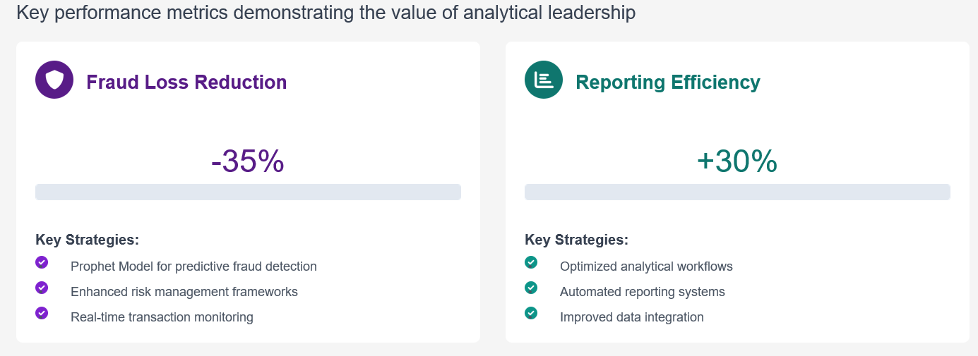
Fraud Surges Align with U.S. Holiday Peaks
Business Impact: Retained the major ticket client leading to profit of few Million Dollars

Slide 8

Prophet Model: Key Components Driving Fraud Detection
Decomposing time series to reveal fraud patterns through trends, seasonality, and holidays
Trend Analysis
Captures long-term growth or decline in transaction volume, highlighting persistent shifts that may indicate evolving fraud risks.
Seasonality Patterns
Isolates recurring cycles like weekly or yearly patterns, enabling identification of normal fluctuations versus unusual spikes.
Model Validation with RMSE
Quantifies forecasting accuracy via Root Mean Square Error, ensuring reliability of fraud detection signals.
Holiday Effects
Models' transaction spikes linked to US holidays, accounting for predictable volume increases to avoid false fraud alerts.
Residual Anomalies
Detects deviations between predicted and actual values using residuals, flagging unusual activity as potential fraud.
Notes:
RMSE metric derivation

Slide 9





Validating Forecast Accuracy with RMSE
Root Mean Square Error (RMSE) measures average forecast error magnitude between predicted and actual values
Demonstrating Prophet’s reliability in detecting fraud patterns over ten years
Lower RMSE scores reflect a better model fit and more reliable fraud forecasting accuracy
Prophet’s RMSE evaluation confirms it captures underlying fraud patterns in credit card phone payments
The findings validations provide objective evidence supporting confident fraud risk predictions

Slide 10
Prophet Model Strengths
Model Limitations & Impact
Prophet Model: Strengths and Limitations in Fraud Detection
1.
Captures multiple seasonality components effectively
1.
Struggles with complex fraud patterns driven by abrupt external or non-temporal factors
2.
Scales efficiently with large datasets
2.
Misses anomalies from sudden shifts without integrating other detection methods
3.
Provides clear interpretability, aiding practical fraud analytics
4.
Supports continuous financial risk monitoring at large scales
3.
Limits comprehensive fraud identification when used standalone
4.
Financial stakes highlighted by million dollar ticket size, underlining need to improve detection
Balancing scalability, interpretability, and detection challenges in high-stakes environments
Business Impact
Delivered measurable client impact: Prophet model integration helped retain Synchrony Bank, one of our largest clients, by improving fraud-risk prediction accuracy and operational efficiency.
Enabled commercial expansion: The solution was successfully marketed to multiple potential clients as a flagship capability, showcasing scalable fraud-detection and ROI benefits.
Generated multi-million-dollar revenue: The deployment and subsequent client adoptions drove several million dollars in annual revenue, reinforcing the model’s strategic and financial value.

Slide 11

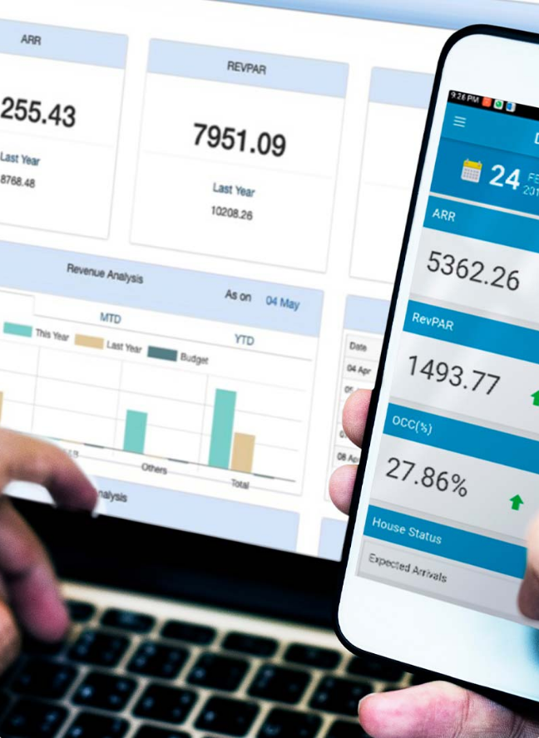

Payments Fraud Detection & Strategy
Evaluation of FraudHacq vendor to enhance fraud detection in merchant onboarding with data-driven financial ROI insights

Slide 12





Evaluation: Visualizing Fraud Risk and Goals
Understanding fraud loss causes and onboarding risk mitigation for strategic action
Fraudulent accounts cause significant financial loss through identity theft and account takeovers, impacting Intuit’s liability.
Primary goal is early fraud detection during account opening to limit losses without hindering business growth.
Graphs highlight the scale of fraud incidents and the mechanisms fraudsters use to exploit new accounts.
Strategic priorities emphasize balancing rapid onboarding with robust fraud controls to protect revenue and customer experience.
Visuals clarify the fraud risk landscape and define objectives to guide vendor integration and risk management.

Slide 13















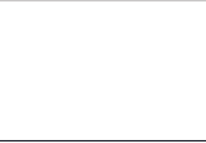





Exploratory Data Analysis of Merchant Fraud Dataset
Metric
Value
Details
Total Applications
21497
Merchant dataset size analyzed
Fraud Rate
6.96%
Proportion of fraudulent applications
Profiling 21,497 Applications with 6.96% Fraud Rate and 17 Key Features
Risk Scores
Internal risk scoring
Used for assessing fraud likelihood
Vendor Features Count
17
Includes phone ownership & VoIP indicators
Key Feature Types
Categorical & Numeric
Phone indicators, risk scores, others

Slide 14
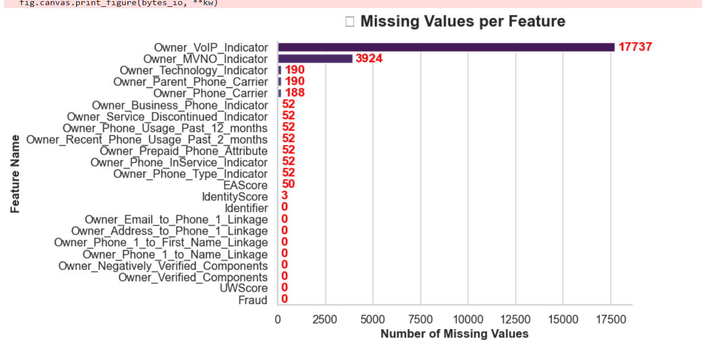
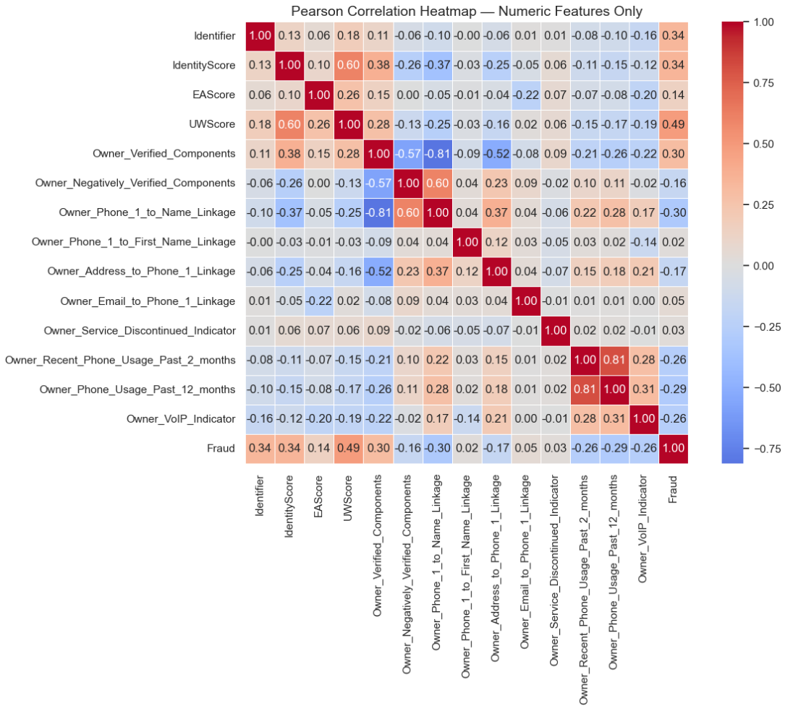
Exploratory Data Analysis
Assessing Correlations and Missing Values
Internal Scores: IdentityScore, EAScore, UWScore
Vendor Features from FraudHacq: 17 features including phone ownership, VoIP/MVNO usage, usage activity, and linkages
Action taken: Encoded missing values as 'Unknown' to preserve signal
Notes:
Feature Pair Correlation Interpretation :
IdentityScore – UWScore 0.60
These two internal model scores move together, likely capturing overlapping fraud-risk information.
Owner_Verified_Components – Owner_Negatively_Verified_Components −0.57
Negative link — the more verified components, the fewer negatively verified ones (expected inverse relationship).
Owner_Phone_1_to_Name_Linkage – Owner_Phone_1_to_First_Name_Linkage 0.60 These phone linkage checks are almost identical in logic, so one could be dropped to avoid redundancy.
Owner_Phone_Usage_Past_12_months – Owner_Recent_Phone_Usage_Past_2_months 0.81 Very high collinearity — both measure similar “activity” signals; you should retain only one for modeling.
UWScore – Fraud 0.49 Higher UW (underwriting) score tends to associate with higher fraud probability — your model or score may already encode risk intensity.
Identifier – Fraud 0.34 Indicates some embedded structure (possibly due to entity-level grouping) but not a causal link.
Variables with |r| ≥ 0.8 (as seen with phone usage features) can cause multicollinearity, meaning:
Regression coefficients become unstable.
Model interpretability declines.
Feature importance in tree models may become skewed.

Slide 15
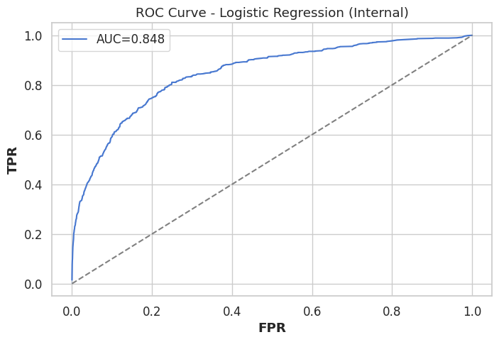
Assumption : Logistic Regression Establishes a Strong Fraud Baseline
Interpretable model achieves AUC 0.848 capturing broad fraud signals from internal risk scores
Leveraging Logistic Regression on Internal Data to Establish a Strong Foundation
The AUC = 0.848 means your model has 84.8% probability of ranking a random fraud case higher than a random good case.
Internal logistic regression model has good discriminative power for fraud detection.
Notes:
X-axis (FPR) → False Positive Rate = proportion of non-fraudulent merchants incorrectly flagged as fraud.
Y-axis (TPR) → True Positive Rate / Recall = proportion of actual frauds correctly detected by the model.
Each point on the blue curve represents a different decision threshold for classifying fraud vs. non-fraud.
The AUC = 0.848 means your model has 84.8% probability of ranking a random fraud case higher than a random good case.
So your internal logistic regression model has good discriminative power for fraud detection.
Your blue curve clearly stays well above this line — meaning the model consistently performs better than random guessing.

Slide 16







Random Forest For Feature Selection
Leveraging Vendor Data and Feature Selection for Higher Precision
Random Forest model uses 300 trees with max depth of 12 to analyze vendor data
Top 15 features selected highlight critical fraud indicators from vendor signals
Enhanced model complements Logistic Regression baseline by incorporating richer data inputs
3
Improved precision and recall metrics demonstrate better identification of fraudulent accounts
Visuals emphasize vendor data’s vital role in advancing model sophistication and results
Notes:
Q. How did you arrive at 300, 12 ? Do a hyperparameter search ?

Slide 17
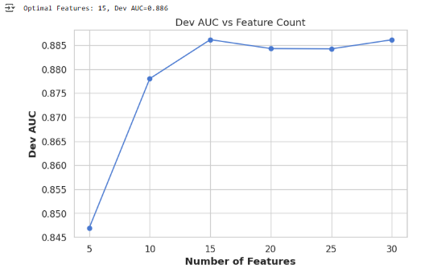
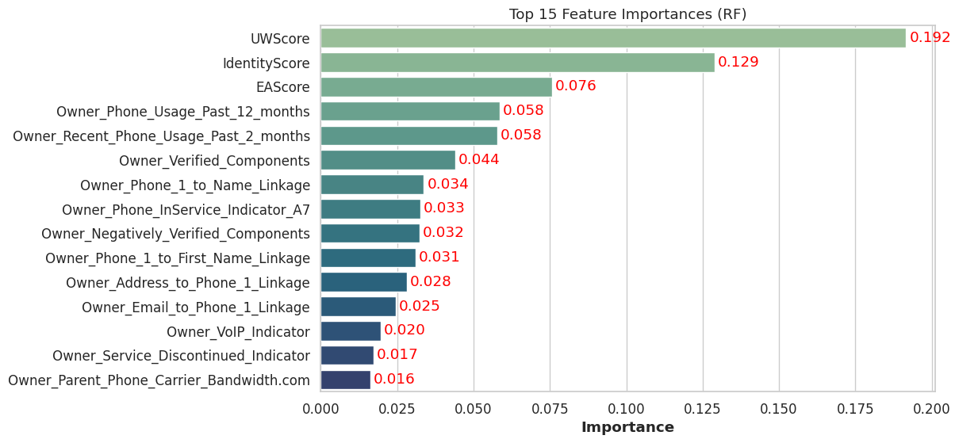
Elevate Fraud Detection with Vendor-Enhanced Models
ROC and Precision-Recall curves show superior detection and precision across thresholds
Random Forest Model Leveraging Vendor Data Boosts Performance, using Random Forest To Select Important Features.
Random Forest model configured with 300 trees and maximum depth of 12.

Slide 18
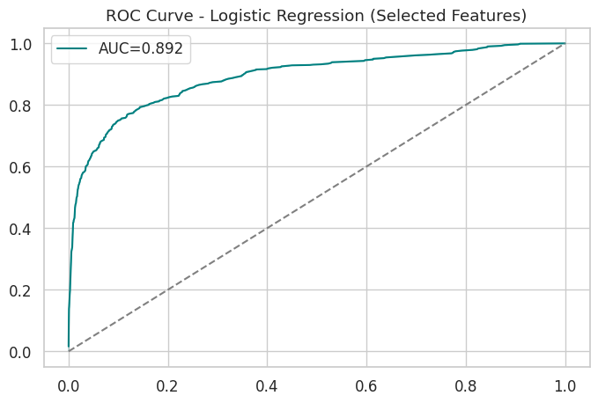
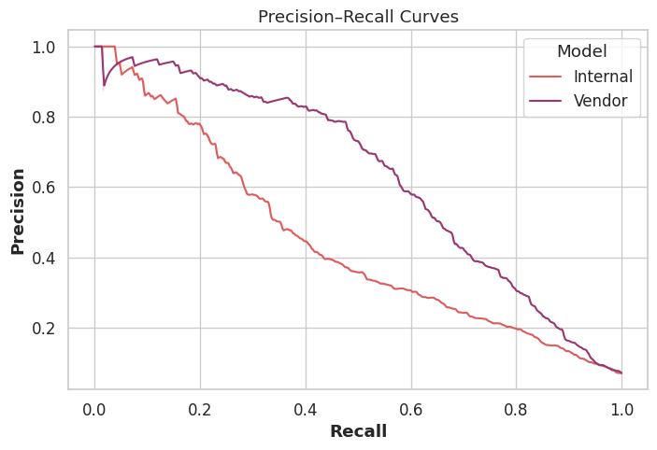
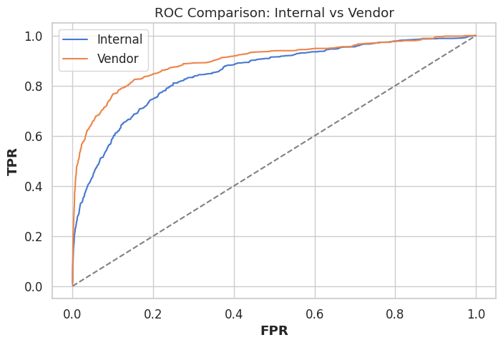
Logistic Regression on Vendor + Internal
Vendor Data Outperforms Internal Model
Vendor ROC curve (Orange) outperforms (blue) across all thresholds.
Vendor achieves higher precision than Internal at every recall level in Precision-Recall analysis.
AUC = 0.892 — meaning the model can correctly rank a random fraudulent merchant above a random legitimate one 89.2 % of the time.
This is an improvement from your earlier internal model’s AUC = 0.848, showing that feature selection increased predictive power by ~4.4 percentage points.
Business Implication
With higher AUC, you can catch more frauds at the same false-positive rate or reduce false alerts for the same recall.
Practically, that translates to lower manual review costs, fewer false declines, and better merchant experience
Notes:
. Business Implication
With higher AUC, you can catch more frauds at the same false-positive rate or reduce false alerts for the same recall.
Practically, that translates to lower manual review costs, fewer false declines, and better merchant experience
Q. Did you explore more models?
(Train a neural network instead of RF, open AI apis AND USE IT IN context learning, classifier)

Slide 19
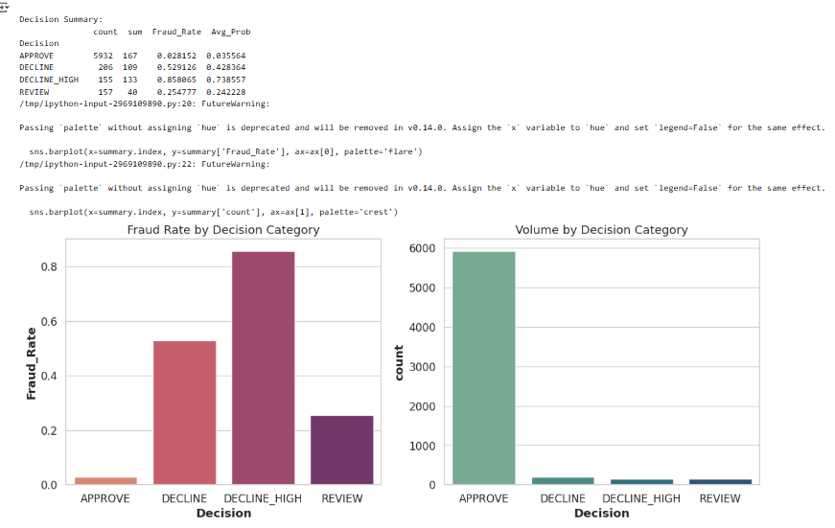

Designing Effective Decision Rules for Fraud Risk
Detailed Analysis of Decision Outcomes and Fraud Rates
Interpretation:
APPROVE: large majority (5932) with very low fraud (≈3%) — your model approves most merchants safely.
DECLINE: fewer in number, about half fraudulent — good targeting.
DECLINE_HIGH: extremely high fraud (≈86%) — strongest signal; this threshold effectively captures high-risk merchants.
REVIEW: moderate fraud rate (≈25%) — borderline cases needing human verification.
Decision
Fraud
Fraud Rate

Slide 20
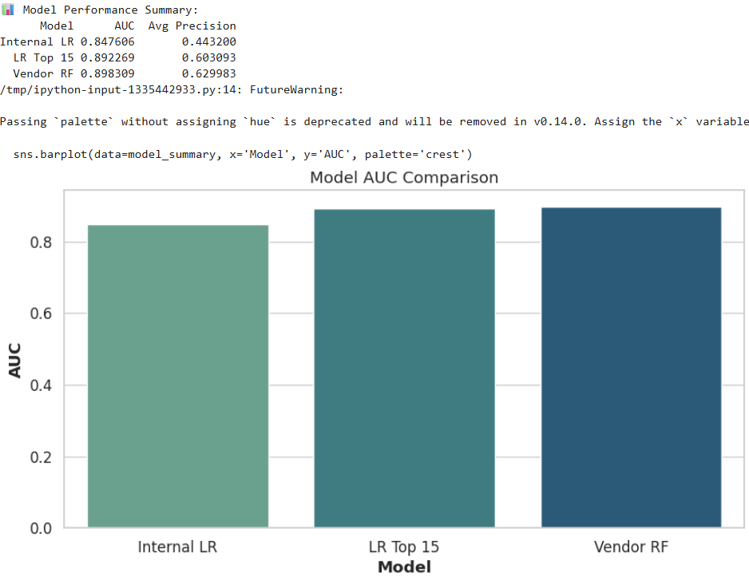
Model Performance Summary
Detailed Analysis of Decision Outcomes and Fraud Rates
A jump from 0.848 → 0.892 → 0.898 represents a progressive lift of ~5% in separability, which is significant for fraud modeling.
Avg Precision , Measures the quality of precision–recall balance, especially under class imbalance (important for fraud detection).
It also rises consistently:
0.44 → 0.60 → 0.63
The models are not only ranking better but also improving actual fraud-catching precision.
BUSINESS IMPACT
This performance lift supports the claim that integrating vendor signals yields multi-million-dollar ROI — retaining key clients and attracting new ones.
Decision
Fraud
Fraud Rate

Slide 21
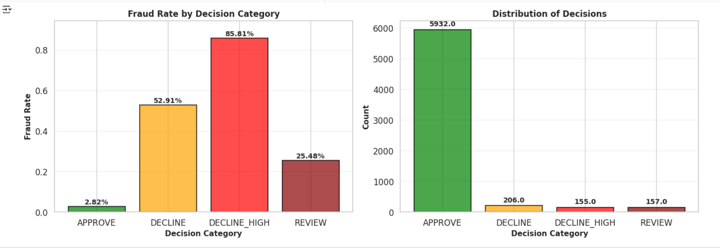
Decision
Fraud
Fraud Rate
Fraud risk increases consistently from APPROVE → REVIEW → DECLINE → DECLINE_HIGH — this is a well-calibrated model.
Dominant majority — most merchants are legitimate. Efficient approval rate for business continuity.
Smaller group — controlled decline rate helps minimize false declines.
Very small, high-risk group — strict filter on obvious frauds.
Balanced volume for manual inspection — keeps review workload manageable.
Business-Level Interpretation
Insight Meaning Action
High precision in approvals (2.8% fraud) Legitimate merchants not wrongly flagged Keep threshold; ensures smooth business onboarding
Strong risk isolation (86% fraud in Decline_High) Very few false declines in top risk group Maintain this cutoff; supports confidence in automation
Balanced review queue (25% fraud) Manual team focuses on uncertain cases Optimize staffing for review queue
Overall calibration Fraud rate rises as decision severity increases Indicates thresholding logic and model scoring are aligned
Notes:
Decision Category Fraud Rate Interpretation
APPROVE 2.82% Very low fraud — most approved merchants are legitimate. Excellent model precision in this segment.
DECLINE 52.91% Roughly half of declined merchants are fraudulent — the model is capturing significant fraud risk here.
DECLINE_HIGH 85.81% Extremely high fraud rate — your strongest risk group; almost all flagged merchants here are fraudulent.
REVIEW 25.48% Mixed-risk zone — about one in four flagged merchants turns out to be fraud, a good region for human review.
Fraud risk increases consistently from APPROVE → REVIEW → DECLINE → DECLINE_HIGH — this is a well-calibrated model.
Business-Level Interpretation
Insight Meaning Action
High precision in approvals (2.8% fraud) Legitimate merchants not wrongly flagged Keep threshold; ensures smooth business onboarding
Strong risk isolation (86% fraud in Decline_High) Very few false declines in top risk group Maintain this cutoff; supports confidence in automation
Balanced review queue (25% fraud) Manual team focuses on uncertain cases Optimize staffing for review queue
Overall calibration Fraud rate rises as decision severity increases Indicates thresholding logic and model scoring are aligned

Slide 22
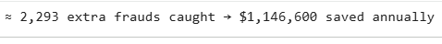

Quantifying Detection Lift and Cost Savings
Visualizing AUC improvements with over $1M annual savings from vendor data integration
Examining key assumptions and financial outcomes driving net profit
AUC Increase
0.05
Value
Annual Savings ($1,146,600)
1
1
Assumptions :
Revenue per approved merchant = $40/month
Fraud loss = $500 per merchant
Review cost = $50 per review
Vendor cost = $0.50 per call
Financial Outcomes:
Revenue = $2.88M
Fraud Loss = $84K
Review Cost = $12.3K
Vendor Cost = $128.9K
Net Profit = $2.66M

Slide 23
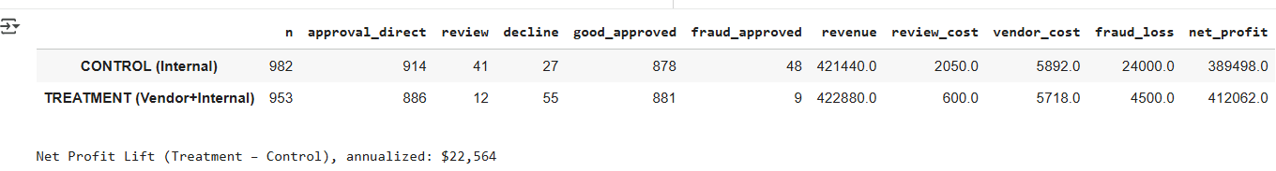
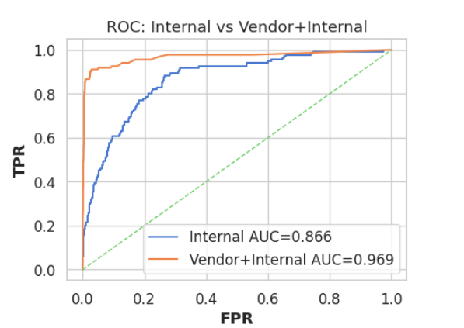
A/B Testing

Slide 24





Optimize Fraud Decisioning with Three-Tier Strategy
Strategically balance rapid onboarding, fraud prevention, and risk management
Auto-Approve: High-confidence, low-risk applications
1
Ensures fast onboarding for low-risk users
Leverages high-confidence data to minimize delays
Auto-Decline: Clear indicators of fraud
2
Automatically rejects applications with obvious fraud patterns
Prevents fraudulent activity efficiently without manual intervention
Manual Review: Accounts flagged as gray zone
3
Triggered by vendor-identified uncertain or borderline cases
Combines expert judgment to balance risk and customer experience
Overall Result: Balanced trade-off between fraud prevention and growth
4
Maximizes onboarding speed without compromising security
Optimizes resource allocation by automating clear cases
Ensures thorough evaluation where needed to reduce risk
Notes:
Gray zone, we can use LLMs here and save some more money

Slide 25
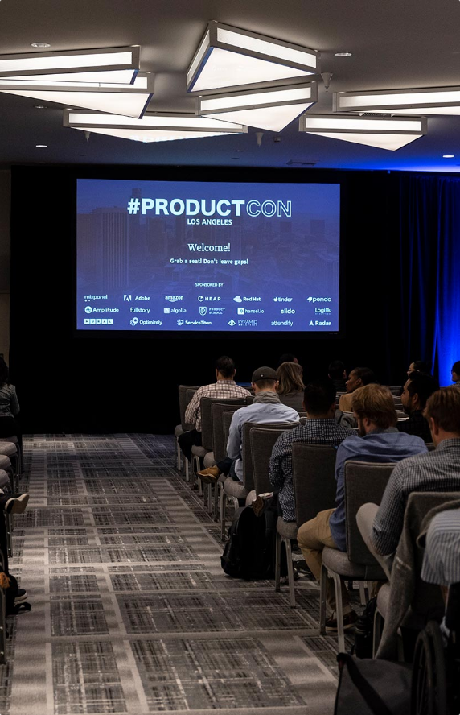


Week 1
KPI Finalization & Feature Stability Testing
Define performance indicators and ensure solution readiness
Accelerated Pilot Execution & Strategic Rollout
Week 2
90-Day Champion vs Challenger Pilot Launch
Compare FraudHacq’s solution against current approach for performance
End of Pilot
Success Evaluation & Profit Uplift Analysis
Confirm profit increase greater than $800K supports solution effectiveness
Two-week pilot roadmap driving an $800K+ profit uplift with minimal overhead
Post-Pilot
Present Findings to Risk Leadership
Recommend broader deployment to maximize measurable fraud reduction
Notes:
Achieve stakeholder alignment and get this prioritized due to the high return on investment in the effort.

Slide 26


Questions?

Slide 27
Appendix

Slide 28
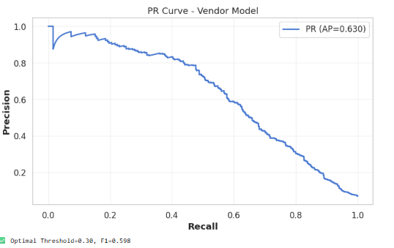
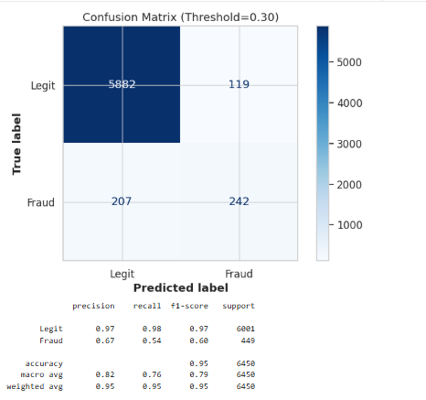
Precision-Recall Threshold
Decision
Fraud
Fraud Rate
Notes:
Understanding the Confusion Matrix
True Label →Predicted LegitPredicted FraudLegit (non-fraud)5882119Fraud207242
True Negatives (5882): Legit merchants correctly identified as legitimate.
False Positives (119): Legit merchants incorrectly flagged as fraud (false alarms).
False Negatives (207): Fraudulent merchants missed (model failed to detect).
True Positives (242): Fraudulent merchants correctly flagged as fraud.
Performance Metrics (below the matrix)
Metric Legit Fraud Explanation
Precision 0.97 0.67 For fraud, 67% of merchants flagged as fraud were actually fraudulent.
Recall (Sensitivity) 0.98 0.54 The model detected 54% of all actual frauds
F1-score 0.97 0.60 Balanced measure of precision and recall — moderate strength for fraud class.
Global metrics:
Accuracy: 0.95 → 95% of total predictions correct (heavily driven by the large legit population).
Macro Avg (0.79 F1) → Balanced performance across both classes.
Weighted Avg (0.95 F1) → Weighted by class size; high because legit dominates.
3. What this means at Threshold = 0.30
The threshold of 0.30 (i.e., merchants with predicted fraud probability ≥ 0.3 are flagged) provides a good precision (few false alarms) but moderate recall (some frauds still slip through).
Lowering the threshold further (e.g., to 0.25) would likely increase recall (catch more fraud) but reduce precision (more false alerts).
So, this threshold reflects a business trade-off:

Slide 29
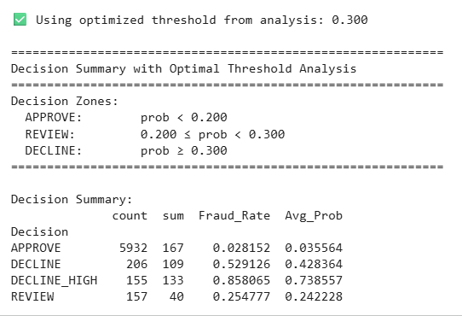
Precision-Recall Threshold
Decision
Fraud
Fraud Rate

Slide 30
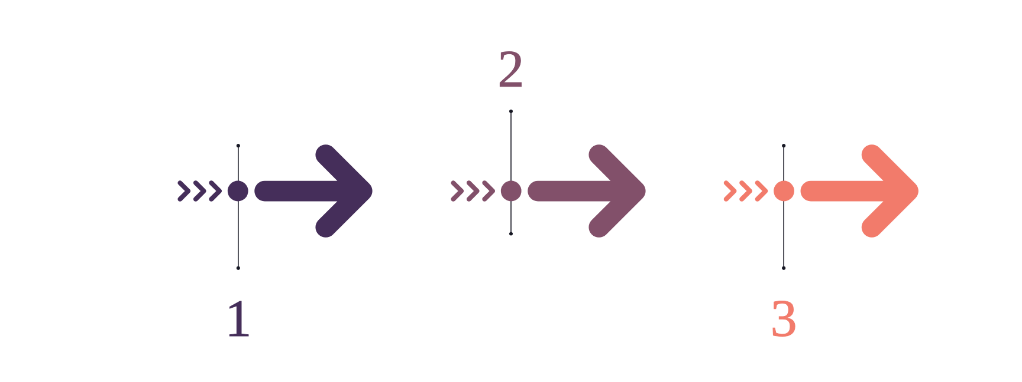
Fraud Decisioning Strategy Optimizes Risk and Growth
A tiered framework streamlines onboarding by balancing rapid approval with fraud prevention and operational efficiency.
Auto-Approve
Manual Review
Fast-tracks low-risk customers using high-confidence data to enable rapid onboarding with minimal fraud risk.
Handles uncertain cases requiring expert judgment to balance fraud prevention and customer experience.
Auto-Decline
Blocks applicants exhibiting clear fraud patterns immediately, minimizing exposure and saving review resources.

Slide 31















Aligning Stakeholders for Optimal Performance
Function
Alignment Focus
Metric
Product
Fast approvals, low friction
Approval rate, latency
Marketing
Channel integrity
Approval/fraud by source
Clear focus areas and metrics per function to drive cohesive success
Ops
Efficient review load
SLA, queue hit rate
Finance
Economic impact
Net profit, ROI
Engineering
Reliability
Data uptime, model drift
Compliance
Fairness & transparency
Adverse-action logging

Slide 32



Drive Unified Fraud Management Through Stakeholder Alignment
Function-specific KPIs with decision-driving visual metrics
Product & Marketing
Operations & Finance
Engineering & Compliance
Approval rates and fraud by source highlight acceptance quality
Review load tracks manual intervention volume to optimize efficiency
Model reliability metrics track fraud detection accuracy and drift
Marketing impact measured through economic value associated with fraud prevention
Economic impact quantifies cost savings and fraud loss reduction
Compliance ensures decision thresholds meet regulatory fairness standards
Finance monitors economic outcomes to inform budget and risk strategies
Product prioritizes end-user experience and fraud model fairness
Cross-functional KPIs align thresholds and processes to reduce fraud impact

